Slide 1
STM32 and VCNL 4010 sensor
Colin LeDonne

Slide 2
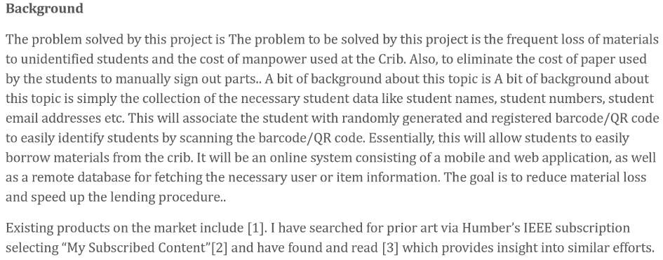
Proposal
Link to full Proposal: https://github.com/asperham/Parts-Crib/blob/master/Documentation/ProjectProposal%20Colin%20LeDonne%20Parts%20Crib.pdf

Slide 3
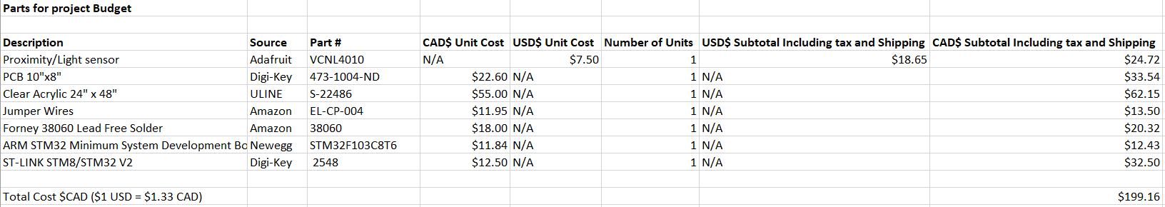
Budget
Link to budget: https://github.com/asperham/Parts-Crib/blob/master/Documentation/Budget.xlsx

Slide 4
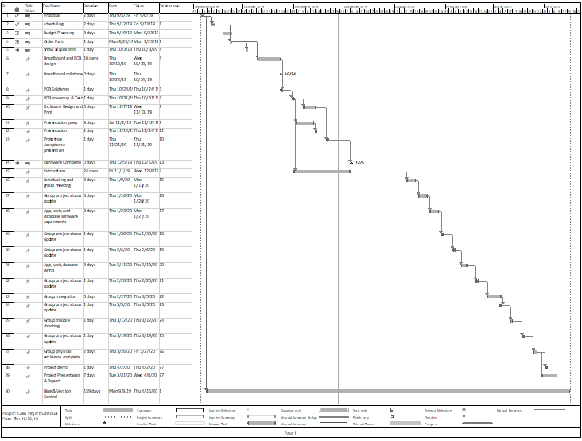
Schedule
Link to Schedule: https://github.com/asperham/Parts-Crib/blob/master/Documentation/Colin%20Project%20Schedual.mpp

Slide 5
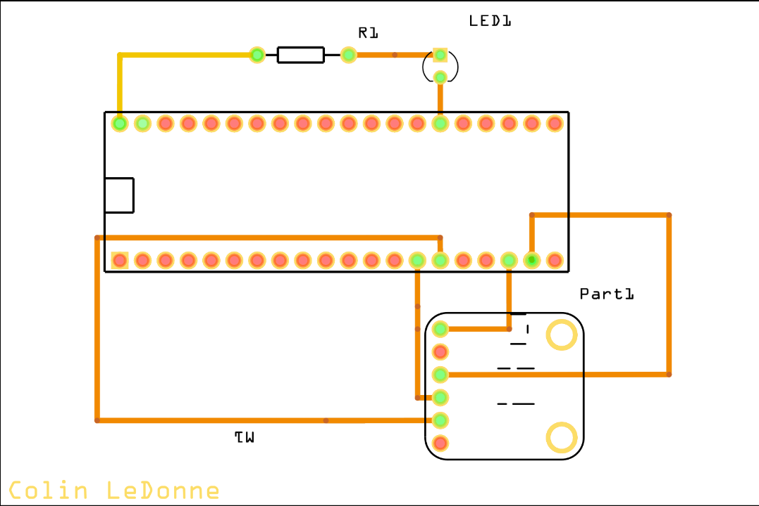
PCB

Slide 6
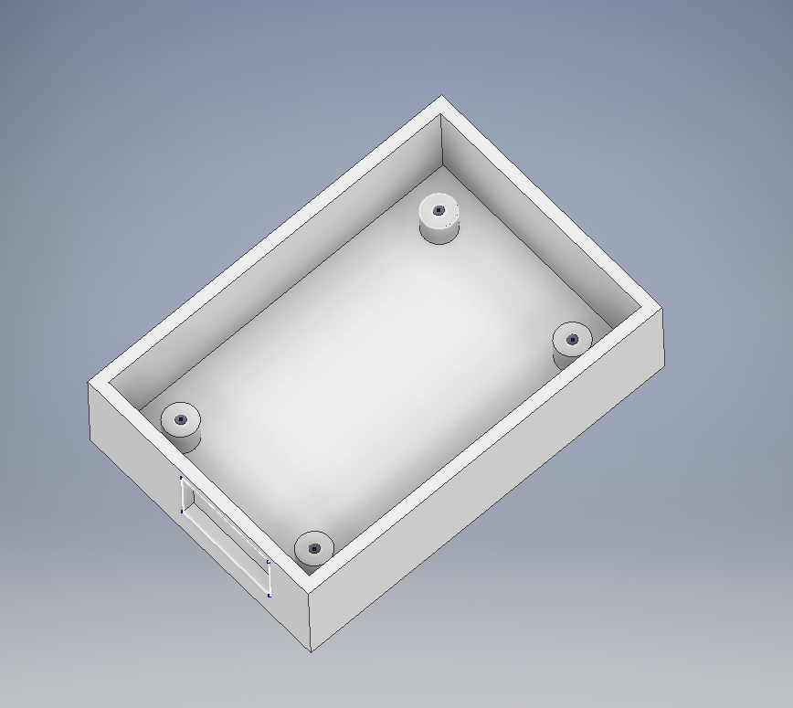
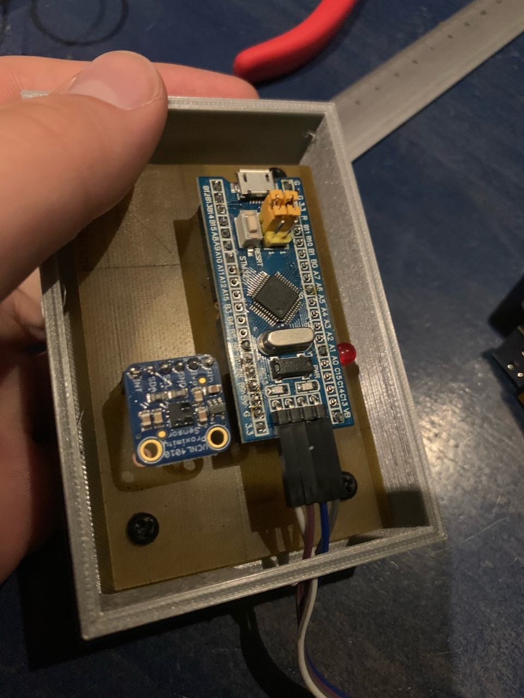
Hardware
3D object file made in autoCAD
PCB in enclosure

Slide 7
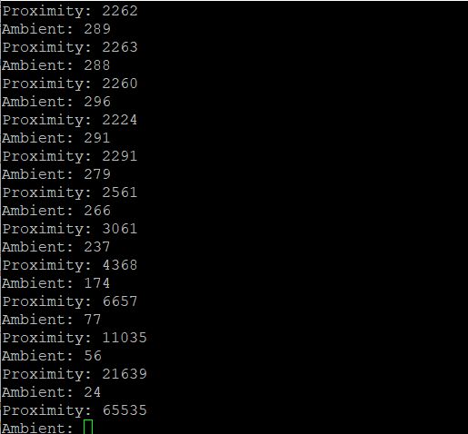
Readings
Uses I2C for I/O
As object gets closer, Proximity gets higher and ambient gets lower

